Slide 1


UNFCCC COP 19
The case of Turkish Industry on transition to low carbon economy: Opportunities and Challenges

Slide 2
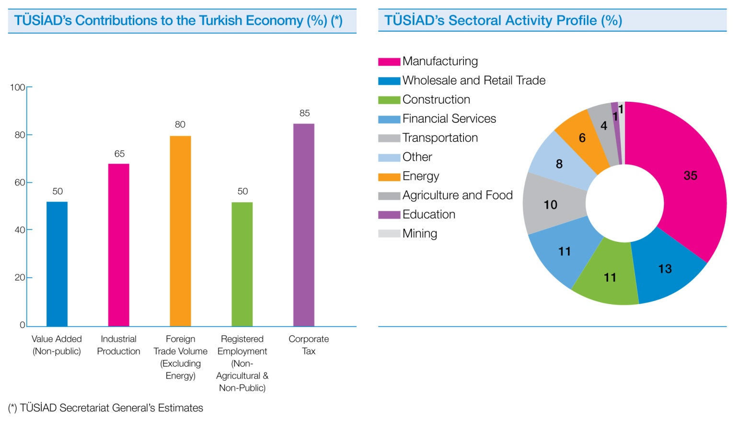
TUSIAD
Turkish Industry and Business Association
A countable partner in policy making
Member of the coordination board on climate change
Notes:
On behalf of TUSIAD secretariat and members I would like to begin my words with thanking U.S Chamber of Commerce and BIZMEF for hosting us at this event. As the only accredit business NGO to UNFCCC from Turkey, TUSIAD actively participates the conferences of parties every year since 2008 and organized side events to make the voice of Turkish industry heard. This year we are happy to find the chance to further interact with our counterparts in this event sponsored by BIZMEF. By this opportunity I would like to give you some information on the case of Turkish Industry on transition to a low carbon economy. But, first of all I think that it will be useful to say a few words on the work of TUSIAD as an interest group representing Turkish private sector. Followingly, I will point out the aspects of Turkish climate change policy, efforts of the Turkish industry on the way to a low carbon economy, the challenges in capacity building to control carbon emissions, and finally our expectations from the course of international negotiations.
TUSIAD is a leading business NGO in Turkey which represent the interests of Turkish private sector. It has approximately 600 members representing 2500 companies, which constitute 65 % of industrial production in Turkey and 80 % of foreign trade excluding energy imports. We are an influential stakeholder in policy making on major areas cross cutting multi sectors such as environment, energy, transport, agriculture and many others. In this context, climate change is one of the high priority issues, where TUSIAD actively pursues the interests of the Turkish private sector. Notably TUSIAD is a member of the Coordination Board on Climate Change which comprises of all relevant parties taking responsibility on climate policy making in Turkey, including the relevant ministries and the private sector under the coordination of the Ministry of Environment and Urbanization. In addition to this, TUSIAD is in close cooperation with international business institutions including World Business Council on Sustainable Development and Regional Environment Center. Moreover, TUSIAD is a member of OECD BIAC and BUSINESSEUROPE.

Slide 3

Climate Platform
A common initiative by TUSIAD and REC Turkey
Members: 20 major companies from various sectors; such as energy, finance, home appliances, automotive and consumer goods
Some of its recent activities;
Trainings on GHG emission calculation and information management systems for the major installations of leading companies in Turkey
Seminars, e.g. ‘Climate Meeting: Future of Carbon Markets’
Various reports, e.g. ‘ICT for Sustainable Development’
Notes:
Bearing in mind the importance of stakeholder cooperation and the necessity to raise awareness on all relevant aspects of climate change for the industry; TUSIAD has initiated Climate Platform in cooperation with Regional Environment Centre Turkey. Climate Platform has 20 members, which are the major companies from various sectors in Turkey including energy, finance, home appliances, automotive, telecommunication, consumer goods, hotels and restaurants. Members of cliamte Platform are represented by Chairmen, CEOs or other high level executives.The platform concentrates its efforts on awareness raising, capacity building and information support on regulatory risks, new technologies and market based mechanisms through seminars, trainings and technical reports on climate change related aspects. The most recent one of them is called ‘ICT for Sustainable Development’ which covers climat change and information technology. Like TUSIAD, RECT Turkey, which undertakes the secretariat of Climate Platform, also participates UNFCCC conferences and provides daily reports on the course of negotiations.

Slide 4
Turkish national policy on climate change
National Climate Change Strategy 2010 – 2020
Turkey’s National Vision: " …A country fully integrating climate change-related objectives into its development policies, disseminating energy efficiency, increasing the use of clean and renewable energy resources, actively participating in the efforts for tackling climate change within its special circumstances "
Goals:
30 % share for renewables in total electricity generation mix by 2023
7 % GHG emission cut in energy generation compared to Reference Scenario by 2020
Through energy efficiency practices the determined energy saving potential shall be realized at maximum levels in the industry.
…
Energy Efficiency Strategy 2011-2023
Decrease energy consumed per unit GDP (energy intensity) by a minimum of 20% by 2023
Notes:
Before mentioning the efforts of Turkish industry on transition to a low carbon economy, I believe that it will be useful to give you some information on Turkish climate change policy and the regulatory instruments. As a party to UN Framework Convention on Climate Change and Kyoto Protocol, Turkey closely follows international negotiations and takes action at national level to facilitate sustainable economic transformation. Within the context of its vision on climate change, the Turkish Government integrates climate related objectives into its development policies. In order to define the general framework of Turkish climate change policy, The Ministry of Envionment and Urbanization adopted the National Strategy on Climate Change in 2010, which was followed by the National Climate Change Action Plan. Some of the goals laid down in this strategy are as:
The share of renewables in total electricity generation mix will be increased to 30 % by 2023
GhG emissions from the energy generation sector will be 7 % lesser compared to Reference Scenario by 2020
Through energy efficiency practices the determined energy saving potential shall be realized at maximum levels in the industry
In addition to this; according to Energy Efficiency Strategy Paper, which was adopted in 2011 it is aimed that Energy consumed per unit GDP (energy intensity) in Turkey by a minimum of 20% by 2023

Slide 5
Policy Instruments Regulatory Mechanisms and Financial Incentives
Renewable Energy Law
Energy Efficiency Law
  Regulation for the Promotion of Efficient Use of Energy and Energy Sources
Regulation on the Program to Support Research and Development Projects in the Energy Sector
Regulation on energy labeling and eco-design
Regulation on energy performance of buildings
Notes:
In accordance with these goals, the policy instruments which are developed so far in Turkey include financial and regulatory incentives for investments on energy efficiency, renewable energy generation and R&D for low carbon technologies. These are:
Differentiated feed in tariff mechanisms laid down in Renewable Energy Law
The legislative framework for investment supports, voluntary agreements and supply side management, provided by Regulation on the Promotion of the Use of Energy Sources and Energy Efficiency
Energy labeling regulation for household appliances defining the grounds for energy efficiency labels on white goods
Regulation on the energy performance of buildings which foresees the certification of the energy efficiency performance of new buildings
Support mechanism for research and technology development projects including renewable and other clean energy options, energy efficiency, and hazardous emission mitigation.
As the public institutions facilitate the necessary regulatory environment and academic institutions make efforts to contribute R & D; TUSIAD, both as a private sector platform and a sivil society organization, takes an active role on not only the effective implementation of the legislation in force but also raising public awareness and capacity building for the fight against climate change. Notably, TUSIAD organizes technology awards in cooperation with Technology Development Foundation of Turkey’s (TTGV) and The Scientific and Technological Research Council of Turkey (TUBITAK); where innovation projects on products and processes are awarded every year.

Slide 6

Support Projects and Mechanisms
  Market Transformation of Energy Efficient Appliances in Turkey
  Improving Energy Efficiency in Industry
  Promoting Energy Efficiency in Buildings in Turkey
  Turkey Sustainable Energy Financing Facility
Notes:
In order to facilitate the implementation of some of these regulations UNDP Turkey and the Ministry of Energy and Natural Resources, has initiated 3 projects on:
Market Transformation of Energy Efficient Appliances in Turkey
Improving Energy Efficiency in Industry
Promoting Energy Efficiency in Buildings in Turkey
In addition to regulatory and financial mechanisms developed by Turkish Government, a new initiative to create a credit line is developed by the European Bank for Reconstruction and Development (EBRD) for SME sized industrial companies and commercial enterprises that wish to invest in energy efficiency or renewable energy projects.

Slide 7
Reflections on the Industry - Progress in Renewable Energy Capacity
Turkey enacted renewable energy law in 2005
Installed Power Generation Capacity
Years | Renewable (MW) | Total (MW)
2006 | 13,144.60 | 40,564.80
2007 | 13,564.10 | 40,835.70
2008 | 14,222.15 | 41,817.20
2009 | 15,422.10 | 44,761.17
2010 | 17,245.60 | 49,524.10
2011 | 18,980.00 | 52,911.10
2012 | 22,032.20 | 57,059.41
Source: TEIAS (Turkish Electricity Transmission Company)
Goal for 2023: Increasing the share of renewables above 30 % in total electricity production
Aimed Installed Capacity for 2023
Energy Source | Aimed Installed capacity (MW)
Hydro | 36,000
Wind | 20,000
Geothermal | 600
Solar | 600
Notes:
When we look at the reflections of these regulatory and financial mechanisms on the industry we see that companies in Turkey are indeed integrating climate change perspectives into their investment decisions. As you can see on the chart, since the renewable energy law entered into force in 2006, there has been a remarkable increase in renewable electricity generation capacity in Turkey, which has nearly doubled by 2012. By 2023, Turkey aims to increase the share of renewables above 30% within the total electricity production. In this respect; aimed installed capacity figures which were defined in ‘Electricity Energy Market and Supply Security Strategy Paper’ for 2023 are
36 GW for Hydro
20 GW for Wind
600 MW for geothermal and
600 MW for solar power

Slide 8
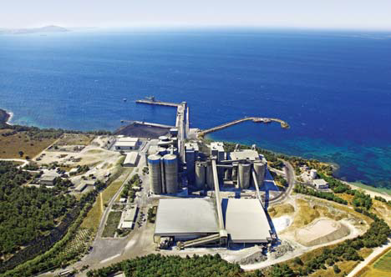


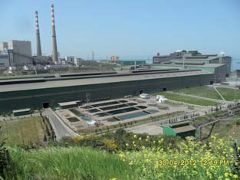
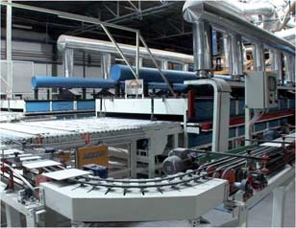
Reflections on the Industry
Investment for Innovation - Best Practices
OYKA PAPER PACKAGING
Biomass Boiler
AKÇANSA
Waste Heat Power Generation Plant
ARÇELİK
Cactus Dishwasher
OY - KA
Paper Packaging
Biomass Boiler
İÇDAŞ
Sustainable Water Management Project
ViTRA
Waste Heat Recovery at Ceramic Kilns
Notes:
In addition to this, firms in carbon intense sectors such as cement, ceramics, iron and steel and household appliances heavily invest in innovative projects on energy efficiency in processes and products. Examples of best practices, some of which are award winning projects at the RIO + 20 summit in 2012 are
Waste Heat Power Generation Project at AKÇANSA Cement production plant in Çanakkale; where 30 % of the energy is generated from the waste heat coming out at the production process
Waste Heat Recovery at Ceramic Production by VITRA; where the waste heat coming out of the ceramic kilns is captured and reused for dry spraying.
Sustainable Water Management Project at IÇDAŞ integrated facilities (iron steel, ship building and transport); which facilitates energy efficient production of fresh water from sea water
Arçelik Cactus dish washer is an example of facilitating water and energy efficiency at the consumption side, as the world’s least energy and water consuming dishwasher (annual electricity consumption: 194kwh and water consumption per wash: 6 liters) and
OYAK Paper Packaging Biomass Boiler, which wood waste (i.e. Bark, nut shell, almond shell, forest waste, chips etc. ) to generate electricity for the operation of the plant itself.

Slide 9
Capacity Building to Control Carbon Emissions
Regulatory Framework
Regulation on Monitoring of Greenhouse Gas Emissions
Communique on Monitoring and Reporting of Greenhouse Gas Emissions (draft)
Communique on Voluntary Carbon Market Project Registration
Challenge
Ensuring well functioning of MRV structure
Notes:
Equally important as facilitating new investments and providing support for academic efforts; capacity building efforts to control GhG emissions is another key issue in the case of Turkey. Notably, the effectiveness of policy instruments and the investments on the way to a low carbon economy can only be measured with countable data on the status of emissions. In this respect establishing a well-functioning monitoring reporting and verification mechanism is vitally important. The legislative framework in this context is recently introduced in Turkey and will be in practise by June 2014. The ability to acquire countable data on the status of emissions is the main basis for market based instruments.
In addition to this; raising awareness on the new market mechanisms is another crucial challenge which requires qualified human resource and in depth consciousness on the risks of climate change at the side of the industry.

Slide 10
Voluntary Carbon Markets
Project Type | Project Number | Annual Emission Reduction (tCO2)
Hydro | 124 | 7.181.723
Wind | 64 | 5.603.468
Biogas | 6 | 514.789
Geothermal | 6 | 405.309
Energy Efficiency | 5 | 151.432
Landfill | 13 | 2.473.093
Total | 218 | 16.329.814
Source: Ministry of Environment and Urbanization, October 2012
Notes:
On the other side there are some recent exercises which shows promising potential on voluntary carbon markets. Turkish private sector is currently able to act on voluntary carbon markets on project basis. Notably, Turkish companies introduced 218 projects (those worth of 16.3 million CO2 emission reduction annually) into voluntary carbon markets 18 % of which is certified.

Slide 11
Crucial Points for the Effectiveness of Ongoing Efforts
A global wide strong consensus
Fair conditions to guarantee level playing field
Sufficient funding and technology transfer mechanisms
Notes:
I would like to conclude my remarks with some words pointing out our expectations from the negotiations under the framework of UNFCCC. As it will be for all other parties, a global wide and strong consensus to combat climate change, is in the interest of the Turkish private sector. We believe that, only under this condition, it can be possible to implement such an agreement in an effective and efficient way. Considering the fact that the course of international negotiations will shape the policies at national level, an inclusive consensus is vitally important to ensure regulatory certainty. Lastly, it is also equally important that, the conditions of this consensus must be fair. In other words, the agreement must take into account the differentiating circumstances of all parties. This is also crucial to guarantee the level playing field. In this respect, Turkey needs to be integrated into the funding and technology transfer mechanisms together with all developing countries.

Slide 12
Thank You…

